Slide 1

Title: Data-Driven Insights for a New Movie Studio
GROUP 7
Subtitle: Strategic Recommendations for Film Production

Slide 2
Table of Contents
Overview of Presentation Structure
Business Overview
Business Understanding
Data Understanding and Analysis
Visualizations
Conclusion

Slide 3
Business Overview
Industry Context: Brief description of the competitive movie industry landscape.
Project Purpose: Providing insights on film industry trends for a new movie studio.
Objective: Identify successful genres, directors, and formats to optimize studio performance.

Slide 4
Business Understanding
Industry Evolution: Changes in technology and audience preferences driving industry growth.
Strategic Goals: Establish a studio to produce diverse, high-quality films catering to various audience segments.
Stakeholders:
Company board of directors
Creative team (content creation)
Marketing & sales team
Audience (content consumers)

Slide 5
Business Question
Core Question: What are audience preferences in the movie industry?
Objective: To understand the movie business and analyze trends to guide production decisions.

Slide 6
Data Understanding and Sources
Primary Data Source: IMDb (film attributes)
Supplementary Sources:
Box Office Mojo: Financial information
MoviesDB: Popularity and ratings
The Numbers: Financial metrics
Data Insights: Overview of the types of data collected

Slide 7
Data Description
Key Columns Analyzed:
Movie Attributes: Title, genre, director, studio, runtime, release details, original language
Performance Metrics: Production budget, domestic and foreign gross, worldwide gross, ROI
Ratings & Popularity: IMDb and MovieDB ratings, popularity scores
Data Notes:
Multi-genre and multi-director films
Domestic gross = US revenue; foreign gross = revenue outside the US
ROI definition: Return on Investment

Slide 8
Data Cleaning Process
Steps Taken:
Merging of datasets
Removal of duplicates and inconsistencies
Imputation for missing values where applicable
Column transformation for analysis-ready format

Slide 9
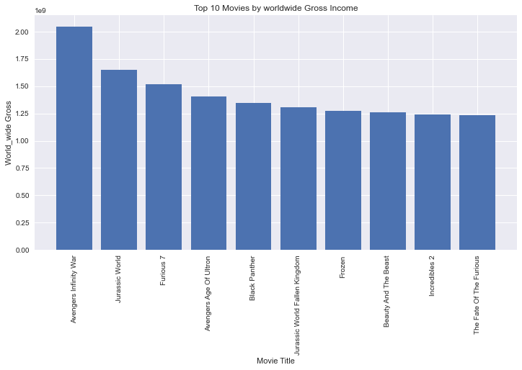
DATA VISUALIZATIONS
Top ten movies by worlwide gross earnings

Slide 10
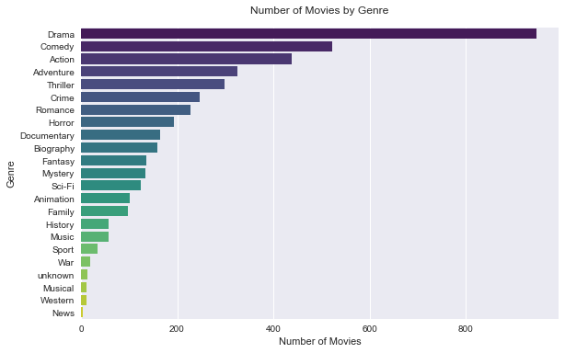
Number of movies per genre

Slide 11
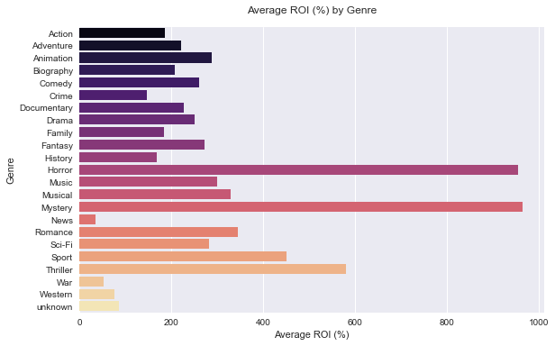
Average Return On Investment (ROI) by genre

Slide 12
Data Visualization - Tableau Dashboard
https://public.tableau.com/app/profile/edwin.maina/viz/Phase2Projectdashboard/Dashboard1?publish=yes

Slide 13
Key Insights
Genres with High Box Office Performance: Based on domestic and worldwide gross
Directors and Formats: Directors associated with top-performing films
Audience Preferences: Key attributes associated with high IMDb and MovieDB ratings

Slide 14
Conclusion
Key Takeaways:
Recommended genres and formats
Insights on audience preferences and high-performing directors
Next Steps: Further analysis into seasonal trends, marketing strategies, and competitive landscape.

Slide 15
Recommendations
Target Genres and Formats: Invest in high-performing genres and popular formats
Focus on Key Directors: Identify directors with a history of successful films in target genres
Audience-Centric Marketing: Align marketing strategies with preferred audience genres and regions

Slide 16
Q&A
Thank You!
Questions?

